Slide 1

Digital Image Processing
National University of Sciences and Technology (NUST)
School of Electrical Engineering and Computer Science (SEECS)

Slide 2
Pixel Connectivity

Slide 3

Pixel Neighborhood
Neighbors of pixel are the pixels that are adjacent to the identified pixel.
(Diagonal Pixels)
(X-1,Y+1)
(X,Y+1)
(X+1,Y+1)
(X-1,Y)
(X+1,Y)
(4 Connectivity)
(X,Y)
(X-1,Y-1)
(X,Y-1)
(X+1,Y-1)
(8 Connectivity)

Slide 4
Distance Measures
We can divide distance between pixels in
following categories
City Block Distance – D₄
Chess Board Distance – D₈
Euclidean Distance - D_{E}
Notes:
4

Slide 5
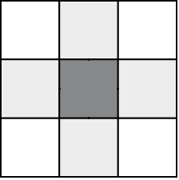
Distance Measures
City block distance (D₄ distance)
2
1
2
1
0
1
2
1
2
Khawar Khurshid

Slide 6
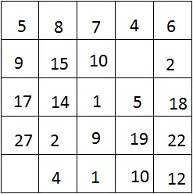
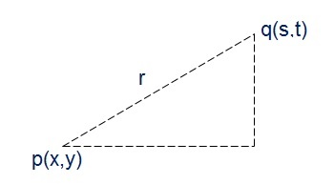
Distance Measures
Euclidean Distance
q(s,t)
D = {(1-4)^2 + (1-4)^2}^0.5
p(x,y)
D = 4.24
Khawar Khurshid

Slide 7
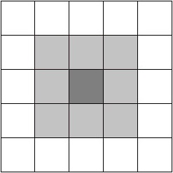
Distance Measures
Chessboard distance (D₈ distance)
2
2
2
2
2
2
1
1
1
2
0
D₈ ₌ D₄ U D_{d}
2
1
1
2
2
1
1
1
2
2
2
2
2
2
Khawar Khurshid

Slide 8
Connectivity
Establishing boundaries of objects and components of regions in an image.
Group the same region by assumption that the pixels are of same color or equal intensity
Two pixels p & q are connected if
They are adjacent in some sense
If their gray levels satisfy a specified criterion of similarity

Slide 9
4-Connectivity
V: Set of gray levels used to define the criterion of similarity
p,q: Pixels being observed
Set of gray levels V = {1}
Notes:
9

Slide 10
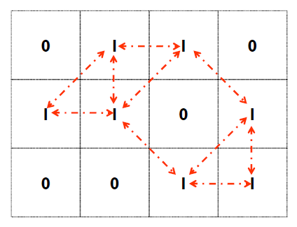
8-Connectivity
V: Set of gray levels used to define the criterion of similarity
P,q: Pixels being observed
Set of gray levels V = {1}
Notes:
10

Slide 11
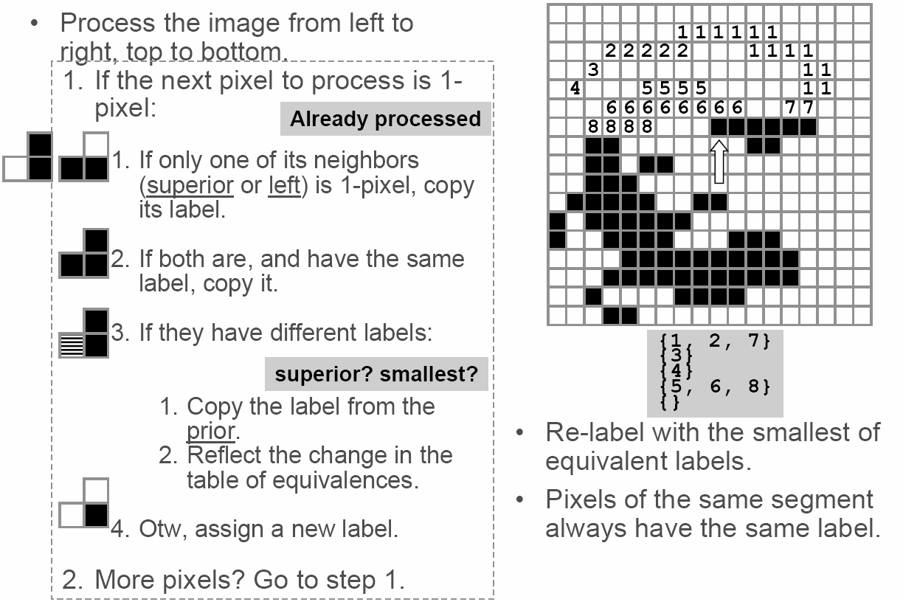
4-Connectivity Labeling
Process the image from left to right, top to bottom:
1.) If the next pixel to process is 1
i.) If only one of its neighbors (top or left) is 1, copy its label.
ii.) If both are 1 and have the same label, copy it.
iii.) If they have different labels
− Copy the label from the left.
− Update the equivalence table.
iv.) Otherwise, assign a new label.
Re-label with the smallest of equivalent labels
Pass 1
Pass 2
Notes:
11

Slide 12


4-Connectivity Labeling
1
2 2 2 2 2
1
3 3 3
2
2
1
3 3
2
2 2 2
3
2
2 2
2
2 2 2
4 4 4
2
Table :
1
, 2
2
3
4
What will be values of table in second scan ?
Khawar Khurshid

Slide 13
8-Connectivity Labeling
Background pixel
Background pixel
Unlabeled Pixel
Unlabeled Pixel
Label 1
Notes:
13

Slide 14
8-Connectivity Labeling
Background pixel
Background pixel
Unlabeled Pixel
Unlabeled Pixel
Label 1
Label 1
Label 2
Label 2
Label 3
Notes:
14

Slide 15
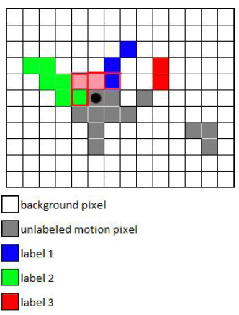
8-Connectivity Labeling
Background pixel
Background pixel
Unlabeled Pixel
Unlabeled Pixel
Label 1
Label 1
Label 2
Label 2
Label 3
Label 3
Notes:
15

Slide 16
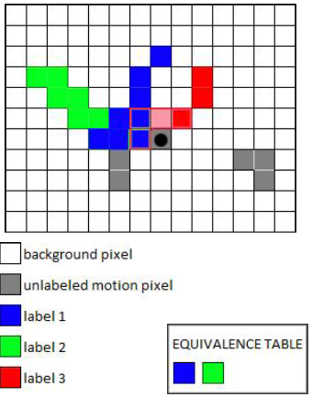
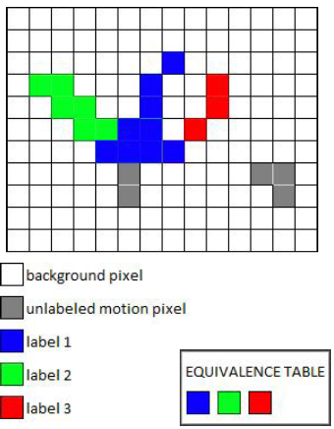
8-Connectivity Labeling
Background pixel
Background pixel
Unlabeled pixel
Unlabeled pixel
Label 1
Label 1
Label 2
Label 2
Label 3
Label 3
Notes:
16

Slide 17
8-Connectivity Labeling
Background pixel
Background pixel
Unlabeled pixel
Unlabeled pixel
Label 1
Label 1
Label 2
Label 2
Label 3
Label 3
Label 4
Label 4
Notes:
17

Slide 18

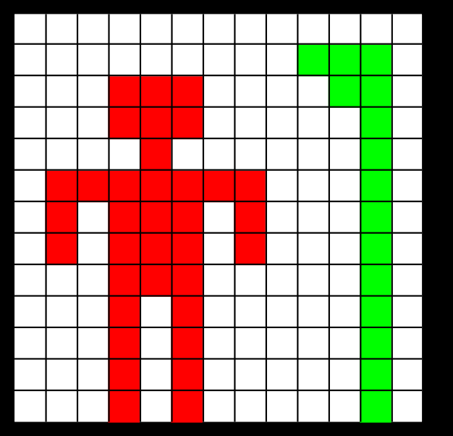
Labeling - Example
Original Image
Labeled Objects
Notes:
18

Slide 19

Labeling - Example
Original Image
Labeled Objects
Notes:
19

Slide 20
End
Pixel Connectivity

